Slide 1
Research Office Workshop
Giving a compelling talk
Rania Nasrallah, PhD

Slide 2
Giving a compelling talk
“If you can harness imagination and the principles of a well-told story, then you get people rising to their feet amid thunderous applause instead of yawning and ignoring you.”
Harvard Business Review
Notes:
Storytelling is the most captivating approach to any presentation, whether academic or not, live or virtual, formal or casual.

Slide 3
On the agenda
How to deliver a compelling talk: live or virtual
Opportunities to improve your skills
Facing the firing squad: Q&A on MS Teams
Always consider the 3 P’s
Participants
Presenter
Presentation

Slide 4
Giving a compelling talk
#1 Know your audience!
What does your audience need?
What do you have to offer?
Types of audience:
live event in a crowded auditorium
academic talk in a classroom or at a conference
virtual live event with unknown participants
virtual session with invited participants
…many other scenarios
Notes:
Focus on one major idea…what you are trying to convey to the audience, what you want them to know (obviously it should be something they want to know about)
Give the audience a reason to care about what you are saying, stir their interest…ask intriguing questions
Build your idea with concepts your audience already understands, what they can relate to

Slide 5
Giving a compelling talk
#2 Be Prepared!
Control your fear…transform your stage fright into positive energy
Check your mindset…be as confident and as assertive as you can be.
Know your key message and focus on this throughout your talk.
What does the audience see?
Face the audience not your slides
Don’t let audience see notes or written speech
Stand still with confidence, moving when needed and to gesture only
Engage the audience with eye contact
Notes:
Practice makes perfect, but a memorized presentation will be just that; try to be spontaneous and respond to the audience, it’ll be more captivating than regurgitating a memorized speech
Practicing won’t help you overcome your stage fright, this comes with experience and with confidence, work on building your confidence and take advantage of every opportunity to talk about your research with others
Know your message, and the transition from slide to slide, memorize a punch line but not the words for each slide, this will help your talk flow much better; especially if you are interrupted by a question

Slide 6
How to deliver your talk
3V’s of communication:
It’s not just “what” but “how” you say it
Verbal: words, grammar, idioms/slang
Vocal: tone, clarity, pitch, pace, volume
Visual: what audience sees about you and your slides…body language (eye contact, arms/hands in pockets or behind back, nervous behaviour, pacing)
Notes:
Non-verbal language could have a longer-lasting impact with the audience than what you say, pay attention to your appearance, expressions and your body language…make your audience feel something about your message, they will remember it easier
Don’t be afraid to look people in the eyes while you are talking.
For virtual talks that means look into the camera not your computer screen.

Slide 7
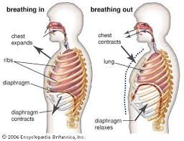
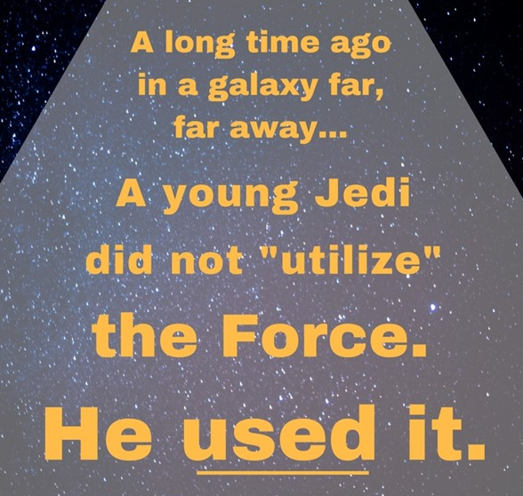
How to deliver your talk
Verbal---What you say:
=
Use simple words…use fewer words to say more
Know the content of your slides and transition smoothly…don’t memorize or read your slides
Use a pause of silence rather than fillers
Use visuals or props…for effect
http://www.nature.com/scitable/topicpage/effective-oral-presentations-13906743
Notes:
Find the most simple and familiar way to get your message across e.g. utilize vs. used
Use visuals or props instead of cramming your slide with words, make sure the audience can relate to what you are saying.
When I used to teach animal physiology and wanted to explain the inspiratory and expiratory phases of respiration, it was easier for students to conceptualize the differences by using a balloon as an analogy
Don’t hesitate, let the presentation flow nicely, but if you do have a memory lapse, or you’re searching for a way to say something, be quiet about it, a small pause won’t be noticed but annoying fillers (um, ah, uh, I mean…) will be.
Not like Trudeau’s 30 sec moment of silence during one of his morning covid19 updates that left everyone wondering…did he forget what he wanted to say or was it intentional?

Slide 8
How to deliver your talk
Vocal---How you say it:
Vary your tone, rate, volume
Emphasize what is important
Be aware and responsive to the audience’s reaction
Focus on positive outcomes to dissipate nervous energy (stage fright)
…be spontaneous, but practice and pace yourself
Imitate excellent speakers!
http://www.nature.com/scitable/topicpage/effective-oral-presentations-13906743
Notes:
Varying the speed at which you talk, and emphasizing changes in pitch and tone all help to make your voice more interesting and keep your audience’s attention.
Speak loudly and clearly towards the audience
If you are nervous, find something in the room to focus on and forget about your negative feelings. Or figure out what will work for you.
Watch talks given by celebrities, TED talks, famous speakers…see who you like and imitate them; record yourself in a video and pay attention to your strengths and weaknesses

Slide 9
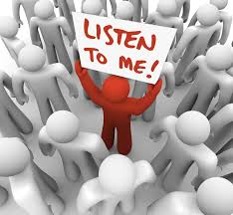
How to deliver your talk
3C’s of communication:
Concision: structure your point
Clarity: use simple language…relatable examples, stories, analogies
Connection: be confident, make eye-contact
The less you say the more they remember!
https://www.forbes.com/sites/karagoldin/2017/06/01/three-cs-of-communication/#7e6c94c32875
Notes:
Slide by slide, have a take home message in text, then use images, graphs, or charts…to illustrate your point
Avoid technical jargon, detailed methodology, complicated concepts…simplify the information so the audience can relate to it, telling stories and using real life examples works best
Don’t talk as though you are the only one in the room, look at your audience and respond to their reactions, stop to ask questions, make sure they are following you
Go back to important points and make sure the audience understood…recaps and summaries help for longer presentations

Slide 10
How to deliver your talk
Preparing for questions:
Anticipate questions for each slide
Listen to the question, make sure you and audience understood it, think and formulate answer (don’t talk over others)
Purpose of questions to help clarify content, be honest (refer if unsure)
Opportunity for feedback to improve your own research…ask questions to audience!
Notes:
Nobody knows your presentation or your work more than you
Question yourself on each slide and anticipate what the audience might ask, and prepare for it
There’s nothing wrong with not knowing, it’s better to say I don’t know then to give a baffled response
Don’t be afraid of asking the audience questions, it’s a great way to collect new ideas for your own work

Slide 11
How to deliver a virtual talk
Virtual Talks:
started with new normal of covid19… and here to stay
same presentation and communication skills apply to live and virtual talks… differ in audience engagement
various advantages and disadvantages to each platform
Notes:
We are all intimidated by the idea of a virtual presentation, whether its anxiety about the unfamiliar technology, or being in the spotlight and not able to see how the audience is reacting
Whether we like it or not, virtual presentations are here and will be in our future…so it’s best to face your fear and improve your presentation style, the skills are developed with experience
Once you pick your platform, and familiarize yourself with the technology, all other aspects of presentation and communication skills are the same as a live presentation…the only challenge is keeping the audience engaged when they are not stuck in a room with you
Use your imagination and creativity and figure out ways to captivate them, start with whatever you are comfortable with and see how it goes

Slide 12
How to deliver a virtual talk
TIPS for keeping the audience engaged
Be brief…attention span 10-11 min
Be prepared…know your technology to minimize glitches, dry-run with same platform and settings, record yourself and see what works
Schedule regular breaks and/or diversions… trivia/quizzes, surveys, take a poll
Keep it simple…avoid long, wordy and boring slide decks, limit complicated graphs and animations
Be creative and captivating… consider standing or performing/impersonating, use simple infographics or animations, use props, use interactive activities, ask audience opinion via chat
https://www.gsb.stanford.edu/insights/10-tips-giving-effective-virtual-presentations
https://www.forbes.com/sites/maryabbajay/2020/04/20/best-practices-for-virtual-presentations-15-expert-tips-that-work-for-everyone/#203af3a43d19
Notes:
There are many challenges to connecting with a virtual audience: in a live session the audience is stuck with you and easier to keep them engaged, for virtual session more opportunities for audience to drift away, get distracted by other home or work priorities
Engage audience every 10 minutes with some activity: chats, polls, raising hands to survey, etc…
Always practice with the same technical configurations and location that you will use for the actual presentation, test your internet signal before starting, poor sound or technical glitches annoy audience and they will leave
Be energetic and animated, or audience will disengage and tune out
If possible, have someone moderate chat…especially for larger audiences
There are many tips and ideas online if you look for ways to deliver a virtual talk

Slide 13
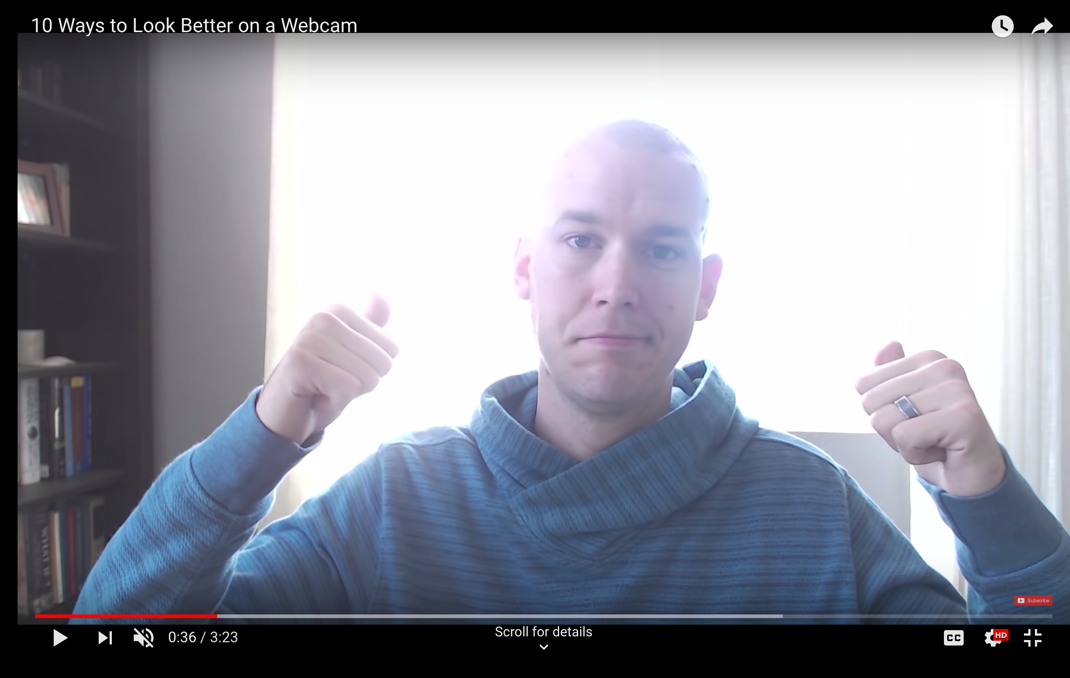
How to deliver a virtual talk
Best Practices For Virtual Talks
appearance matters: adjust front lighting and reduce back lighting, dress and behave as though in a live event
professional background: limit distracting clutter, sound (do a sound check before starting)
position your camera: place camera at eye level, look straight into camera to mimic eye contact
Notes:
Don’t make the mistake of thinking you are not presenting in person, so it doesn’t matter what you look like…appearances matter, and looking unprofessional is the easiest way to turn people away
If you want people to respect you and take you seriously, pay close attention to what you are wearing, the clutter behind you, the lighting, the position you take in the screen…make it easier for your audience to pay attention to your talk by limiting any distractions
Practice your positioning and distance in the camera, you want your head, neck and shoulders to show and at the right level…not just a head shot and not angled from up or down (nobody wants to look up your nose for an entire presentation, and your face will look blown up from a down angle), people connect with faces so you can’t be too far away either
Record your presentation during a dry run, see what you like and don’t like, and adjust
Standing to present keeps you focused and allows you to use good presentation delivery skills

Slide 14
How to give a compelling talk!
BOTTOM LINE!
Captivate your audience from the start…ask a question, tell a story, be witty, use an image as a teaser
Make eye contact and engage your audience
Emphasize your key message…turn your talk into a story from start to finish
Close your talk in a constructive revolutionary way…make your audience feel something…a feeling lasts longer than words
Focus on what your audience needs to know...less is more
OTHERWISE DON’T SAY IT
Notes:
An effective way to begin any talk—interesting story, a surprising statistic, an unexpected observation, or a thought-provoking question. Think of TED TALKs
End your talk in a positive, constructive way: a call to action; emphasize change; finish off a story or discussion from the start of your talk… audience needs a sense of closure.
DON’T: look downwards or stare at podium, sit, read, stand still, speak in a monotone or mumble, get lost in details, not use visual aids, ignore audience reaction
DO: stand, talk, move around, speak loud and clear towards audience, vary pitch of voice, make eye contact with audience, focus on main arguments and relevant points, use visual aids, summarize your points at beginning and end, mimic excellent speakers

Slide 15
Presentation structure
#3 How to prepare your presentation
Keep the slides simple, clear and purposeful…aim to inform not only impress
choose simple, light-colored backgrounds, dark font, and limit special effects
Emphasize the motivation for the work and its outcome, and present enough evidence to validate it (FOCUS!!!)
AVOID details, tangents, crammed slides
Avoid too many words and bulleted lists: max 4-5 bullets
Slides convey your message, not a memory tool (no cheat sheets)
Notes:
Limit the words on the slide, nobody should have to read, they won’t pay attention to what you are saying
Words on slides should be understandable, limit abbreviations and technical jargon
Make sure labels and axes titles are readable, small fonts that can’t be read should be avoided, if it needs to be that small then obviously doesn’t need to be there
Avoid messy tables with endless columns and rows, if can’t be avoided highlight the section you want to emphasize, or crop out what’s not important
Make two slides if needed

Slide 16
Presentation structure
Assertion-evidence slides:
State your take-home message (2 line max) as heading
Develop your message (rest of the slide) supported by visual aids: outlines, images, diagrams, charts…
Use appropriate font style and size
Calibri (Arial, sans serif), 36 pts-heading, 24-body, 14-references
Limit distractions: typos, grammatical errors
Limit animations: opportunity to ask a question or engage audience
Notes:
assertion-evidence slides help convey your message focussing on visual aids, limit words on slide

Slide 17
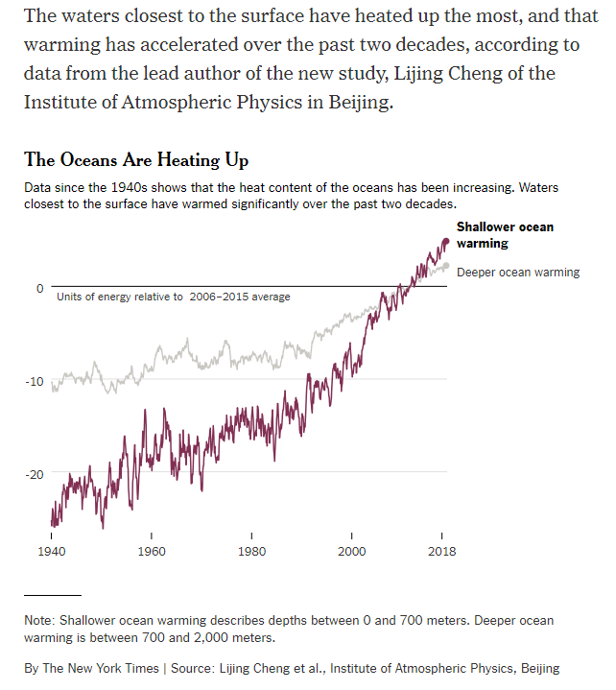
Presentation structure
The TITLE says it all…
"The ocean surface temperature increased much faster than anticipated"
OR
"Evolution of ocean temperature as a function of time"
https://www.nytimes.com/2019/01/10/climate/ocean-warming-climate-change.html
Notes:
Pay close attention to the words you use in your title; the message should be informative and clear…

Slide 18
Useful links
Tips for effective oral presentations:
Effective oral presentations: structure, slides, questions
https://www.nature.com/scitable/ebooks/english-communication-for-scientists-14053993/118520778/
Academic talks
https://faculty.washington.edu/kate1/ewExternalFiles/howtotalk.pdf
Storytelling that moves people
https://hbr.org/2003/06/storytelling-that-moves-people
How to give a killer presentation
https://hbr.org/2013/06/how-to-give-a-killer-presentation
How to give a successful TED talk
https://speakupforsuccess.com/create-a-ted-talk/
How to create and deliver an assertion-evidence presentation
http://writing.engr.psu.edu/speaking.html

Slide 19
Opportunities to improve your communication skills

Slide 20
How to improve your skills
the more you practice the better you will get
Attend research seminars, participate by asking questions
Attend networking events and opportunities to discuss your work
Participate in group discussions (brown bag lunches, informal research events)
Take advantage of opportunities to communicate your work in lay language: 3MT, thesis competition, storytellers
Attend seminars and conferences, as audience and presenter…observe and appreciate the details

Slide 21
uOttawa 3-Minute Thesis Competition
Who: Graduate students enrolled at uOttawa
What: 3-min oral presentation of your research
Why: cash prizes, winner moves on to provincial competition
SEE FOR YOURSELF …quite impressive
https://threeminutethesis.uq.edu.au/watch-3mt
https://www.uottawa.ca/graduate-studies/students/3MT-competition
Notes:
The Three Minute Thesis (3MT) competition is simple: in no more than three minutes (and not a second more!), you must communicate the key concepts and significance of your own research, while engaging the audience.
The 3MT competition can be tremendously enriching and is the perfect opportunity for you to develop your academic and personal communication skills. Members of the audience must be able to understand the passion behind your research, but also how your research can be useful today. Winners of the local 3MT competition receive cash prizes and the opportunity to represent uOttawa at the provincial competition!

Slide 22
Telfer Annual Thesis Competition
IMPROVE YOUR COMMUNICATION SKILLS
Thesis competition highlights:
hosted by TGRPSA
friendly annual competition for all Telfer graduate research students
feature your research, improve your communication skills
compete for cash prizes
Notes:
The competition is open to PhD and MSc students in the EBT, health systems and management programs. Students at all stages of the research process are encouraged to participate.
This is an excellent opportunity to present your research in lay language and discuss your work with your peers.

Slide 23
SSHRC Storyteller Competition
Who: Canadian/PR, > 19 years old, enrolled in Canadian postsecondary institution, working on SSHRC funded project
What: 3-min video/podcast of your research, 300-word infographic
Why: cash prizes, global recognition, five winners move on to Storytellers Showcase at the SSHRC Impact Awards Event
https://www.youtube.com/watch?v=V6ewEZlBFyQ&list=PLww1dvjSoO4NABmm2TW6vpfZ1004E5_pV
RO contest… 500$ for production cost
http://www.sshrc-crsh.gc.ca/society-societe/storytellers-jai_une_histoire_a_raconter/index-eng.aspx
Notes:
Develop your communication skills and gain experience talking about your research to a lay audience.
Excellent opportunity to showcase your research and gain global recognition for your work

Slide 24
BOTTOM LINE
Start preparing early
Know your message…what does your audience need to know?
Use simple, clear, concise language…storytelling works best
Connect with your audience from the start
Keep your audience awake and engaged
Keep the same message throughout!

Slide 25
CONTACT INFORMATION
Rania Nasrallah-Massaad, PhD
Research Development Officer
Research Office: DMS 4151
613-562-5800 ext. 2986
rania.nasrallah@telfer.uottawa.ca
Notes:
If you have any questions you can reach me by email anytime.
I will be holding a virtual Q&A session on August 19th, 2020, at 2 pm for those who would like to ask me questions.
The MS Teams link will be in the email I sent you and in the Research Office newsletter.

